Slide 1
Lecture 6
Shortest Path Problem

Slide 2
Quiz Sample
True or False
Every dynamic programming can be analyzed with formula:
Run-time = (table size)
x (computation time of recursive formula).
Answer: False
A counterexample can be seen in study of the shortest path problem.

Slide 3
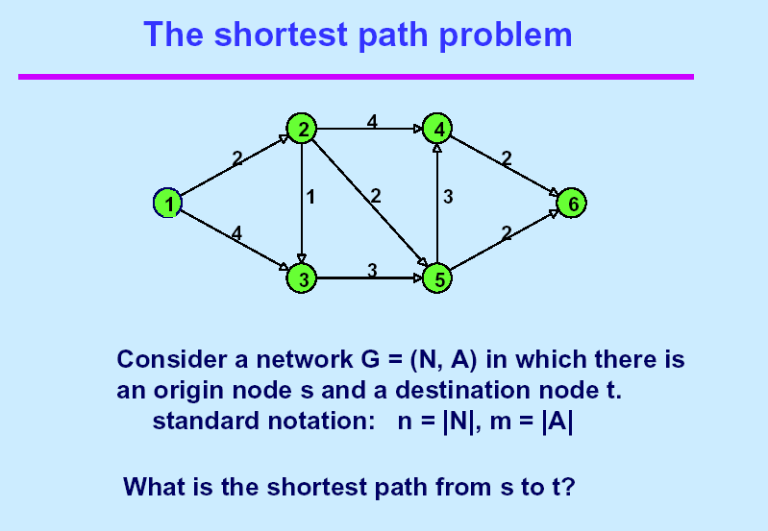
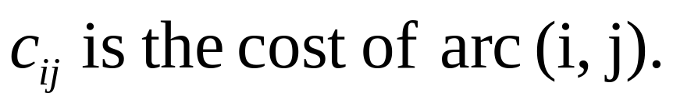
s
t

Slide 4
Dynamic Programming

Slide 5
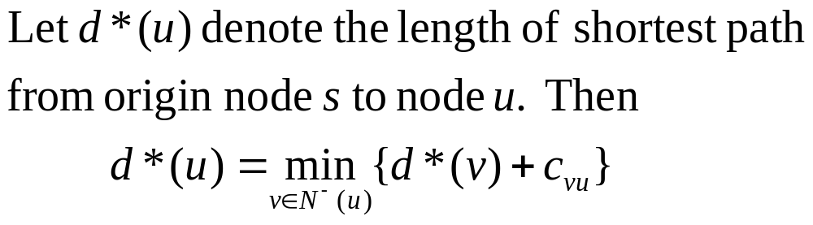
Dynamic Programming

Slide 6
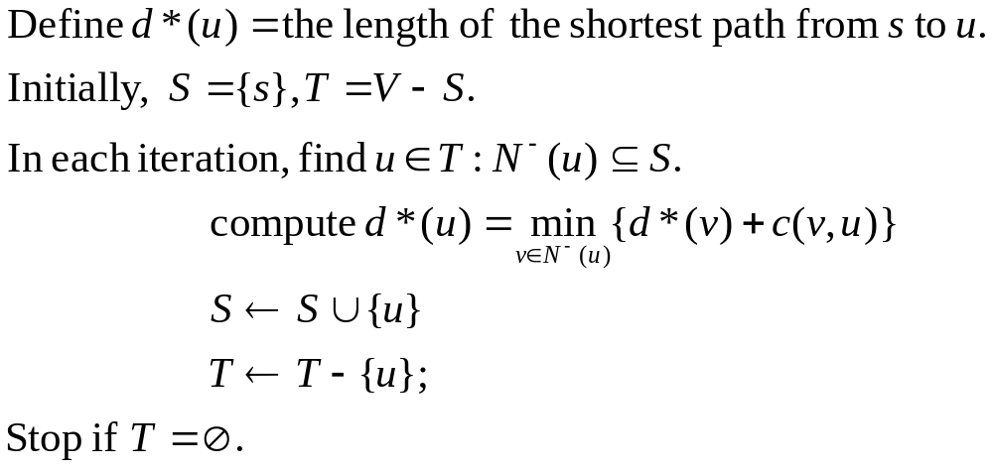
Dynamic Programming

Slide 7
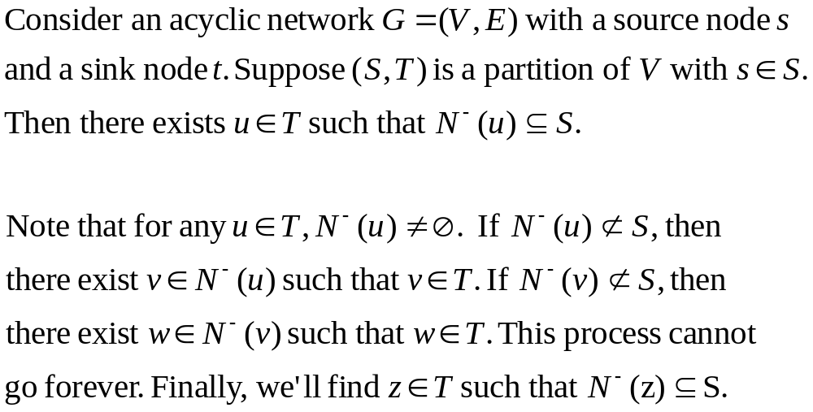
Lemma
Proof

Slide 8
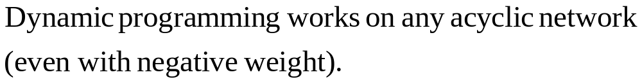
Theorem
2
-1
-1
2
1

Slide 9
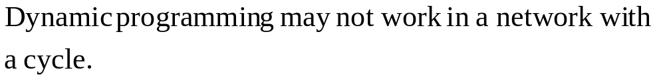
Counterexample

Slide 10
Quiz Sample
True or false?
Every algorithm of dynamic-programming type can use the following formula to estimate its running time:
running time = (table size) x (computing time
for recursive formula).

Slide 11
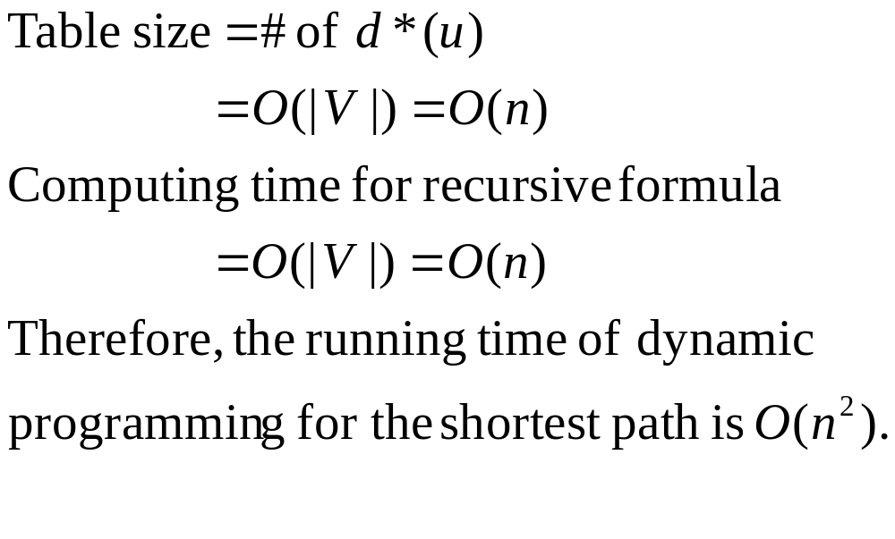
Running Time
Is above calculation correct?

Slide 12
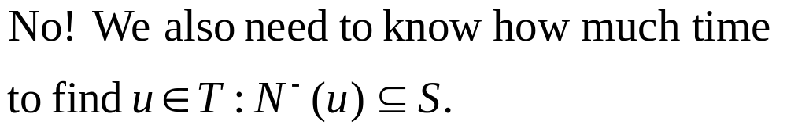
Running Time
Is above calculation correct?

Slide 13
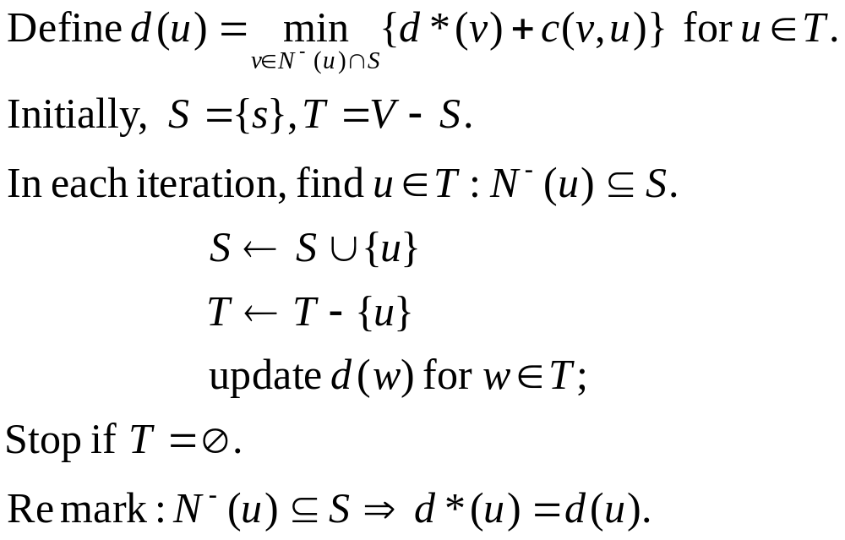
Smart Implementation

Slide 14
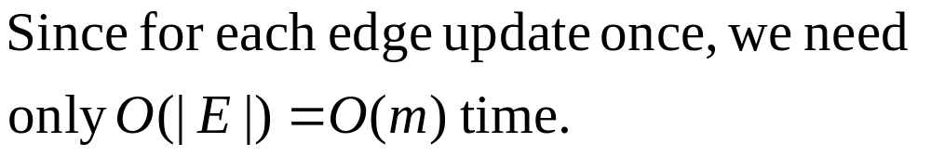
Running Time
how much time do we need?

Slide 15
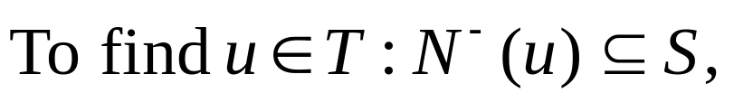

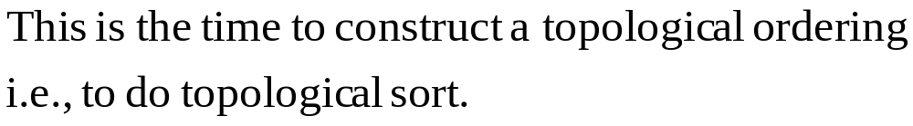
Running Time
how much time do we need?
A topological ordering is an ordering of
nodes such that for any edge (u,v), u is
put before v.

Slide 16
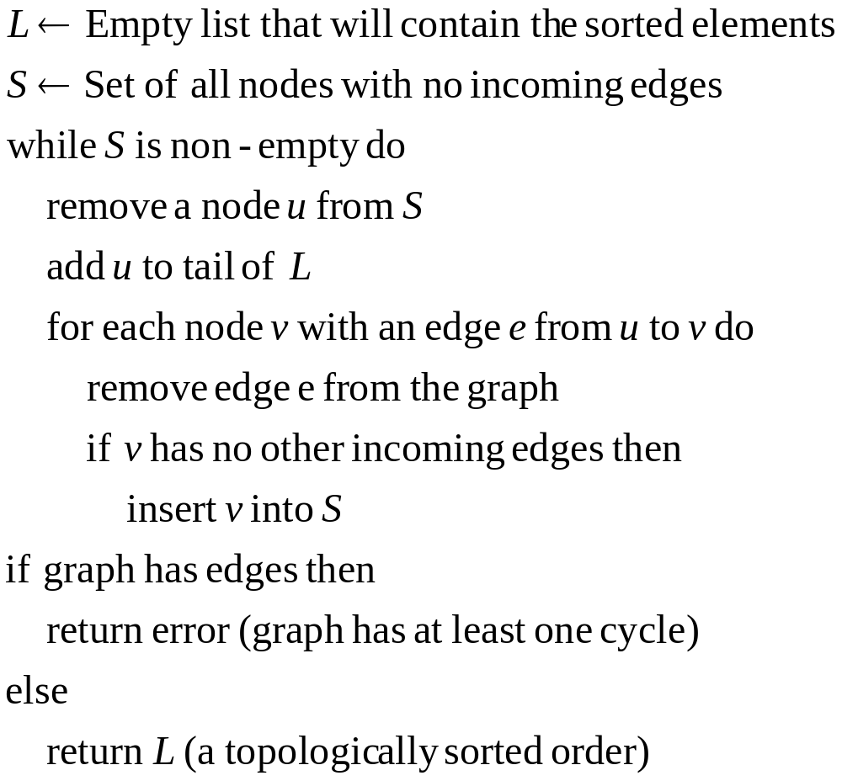
Topological Sort (Kahn)

Slide 17
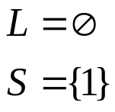
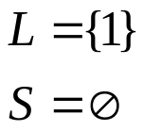
An Example
2
4
4
2
2
1
1
2
3
1
6
4
2
3
3
5

Slide 18
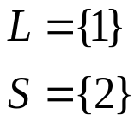
An Example
2
4
4
2
2
1
1
2
3
1
6
4
2
3
3
5

Slide 19

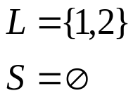
An Example
2
4
4
2
1
1
2
3
6
2
3
3
5

Slide 20
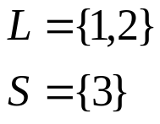
An Example
2
4
4
2
1
1
2
3
6
2
3
3
5

Slide 21
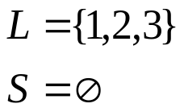
An Example
2
4
2
1
3
6
2
3
3
5

Slide 22
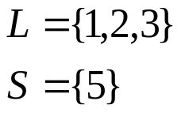
An Example
2
4
2
1
3
6
2
3
3
5

Slide 23
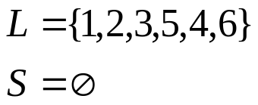
An Example
2
4
2
1
3
6
2
3
5

Slide 24
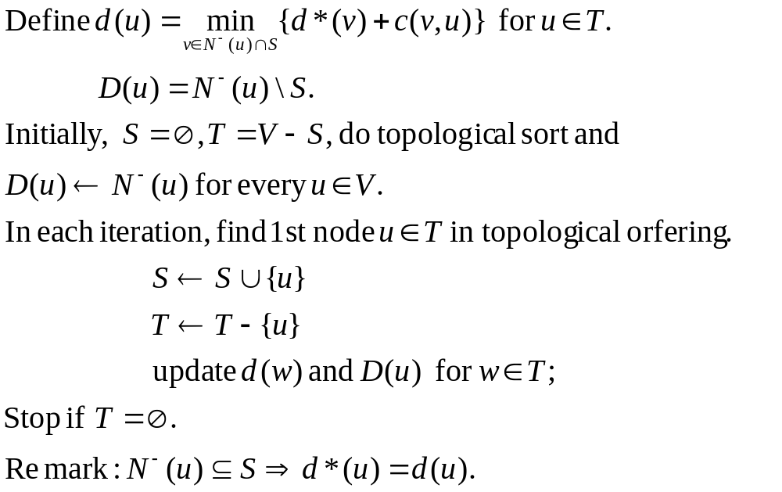
Smart Implementation

Slide 25
Theorem
Dynamic Programming is a linear time algorithm for the shortest path problem in acyclic networks, possibly with negative weight.
Corollary. In acyclic networks, the longest path can be computed in linear time. (QE 2015F)

Slide 26






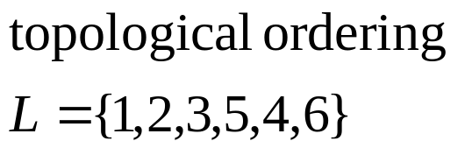
An Example
∞
∞
2
4
4
0
2
2
1
1
2
3
∞
1
6
4
2
3
3
5
∞
∞
Initialize
Select the node with the minimum temporary distance label.

Slide 27

Update Step
2
∞
∞
2
4
4
0
2
2
1
1
2
3
6
∞
4
2
3
3
5
∞
∞
4

Slide 28
Choose u such that D(u)=Ǿ
2
∞
2
4
4
0
2
2
1
1
2
3
6
∞
4
2
3
3
5
4
∞

Slide 29


Update Step
6
2
∞
2
4
4
0
2
2
1
1
2
3
6
∞
4
2
3
3
5
4
∞
3
4
The predecessor of node 3 is now node 2

Slide 30

Choose u Such That N_(u) S
2
6
2
4
4
0
2
2
1
1
2
3
6
∞
4
2
3
3
5
3
4

Slide 31
Update
2
6
2
4
4
0
2
2
1
1
2
3
6
∞
4
2
3
3
5
3
4
d(5) is not changed.

Slide 32
Choose u s.t . N_(u) S
2
6
2
4
4
0
2
2
1
1
2
3
6
∞
4
2
3
3
5
3
4

Slide 33

Update
2
6
2
4
4
0
2
2
6
1
1
2
3
6
∞
4
2
3
3
5
3
4
d(4) is not changed

Slide 34
Choose u s.t. N_(u) S
2
6
2
4
4
0
2
2
1
1
2
3
6
6
4
2
3
3
5
3
4

Slide 35
Update
2
6
2
4
4
0
2
2
1
1
2
3
6
6
4
2
3
3
5
3
4
d(6) is not updated

Slide 36
Choose u s.t. N_(u) S
2
6
2
4
4
0
2
2
1
1
2
3
6
6
4
2
3
3
5
3
4
There is nothing to update

Slide 37
End of Algorithm
2
6
2
4
4
0
2
2
1
1
2
3
6
6
4
2
3
3
5
3
4
All nodes are now permanent
The predecessors form a tree
The shortest path from node 1 to node 6 can be found by tracing back predecessors

Slide 38
Dijkstra’s Algorithm
Find the shortest path from a network with nonnegative edge weights.

Slide 39
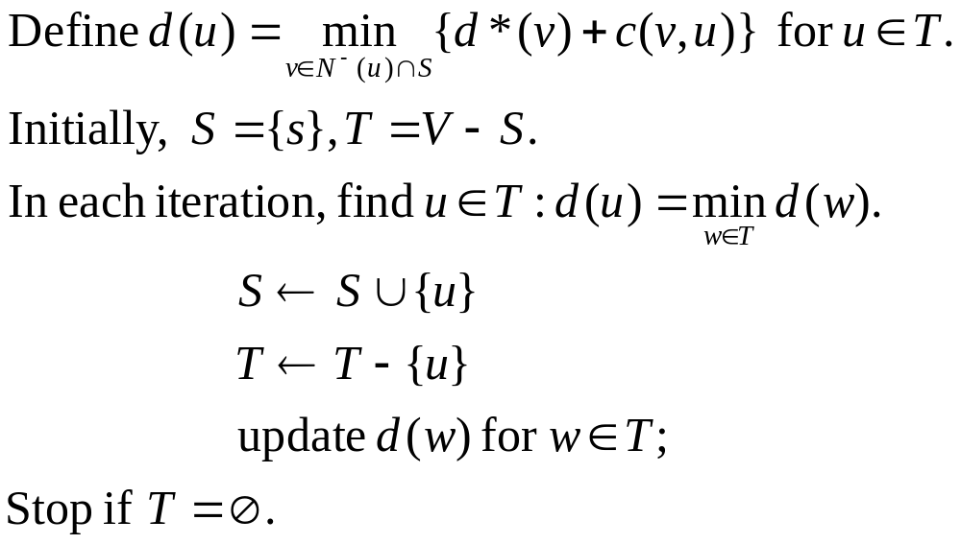
Dijkstra’s Algorithm

Slide 40
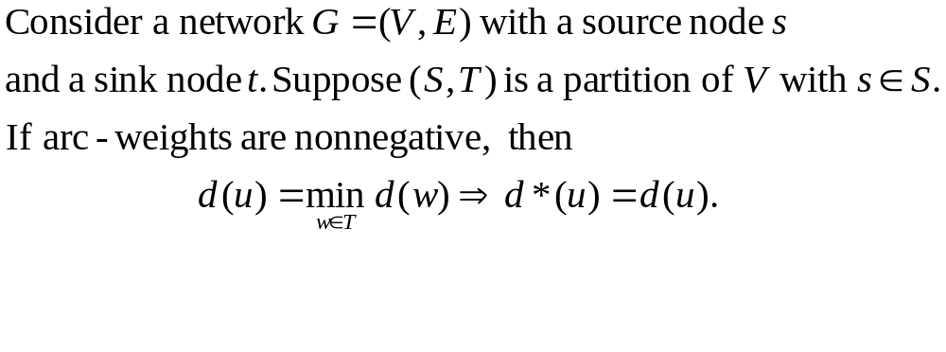
Lemma

Slide 41
Lemma

Slide 42
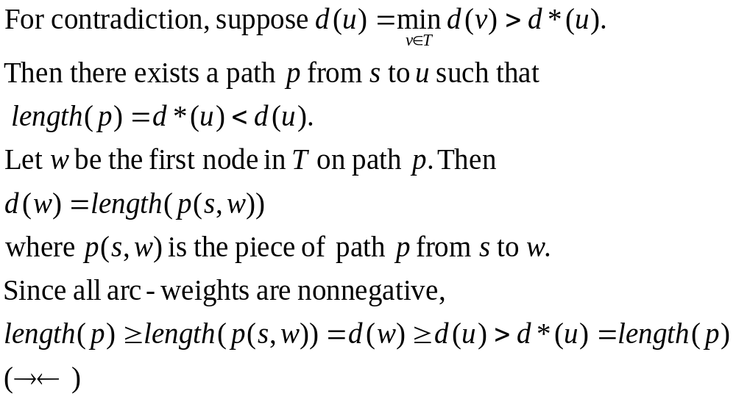
Proof of Lemma
T
w
u
s
S

Slide 43
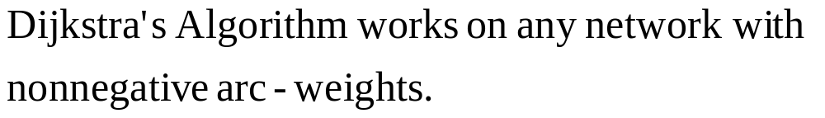
Theorem

Slide 44
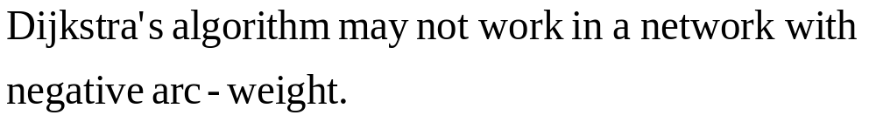
Counterexample
3
-1
-2
2
1

Slide 45
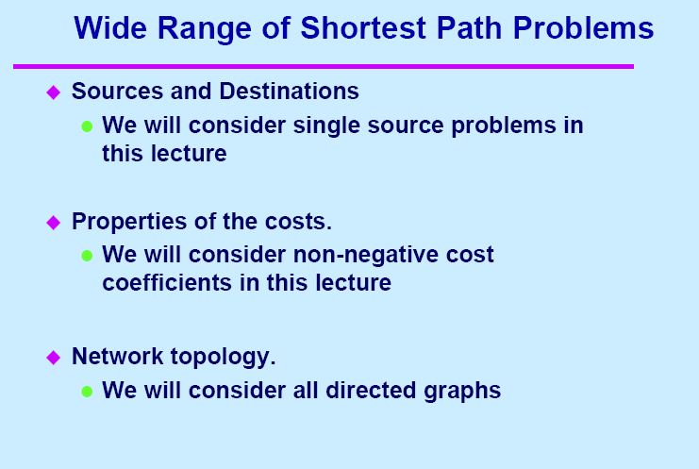

Slide 46
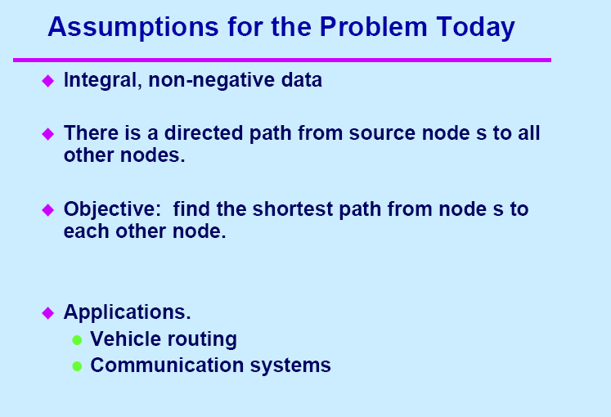

Slide 47
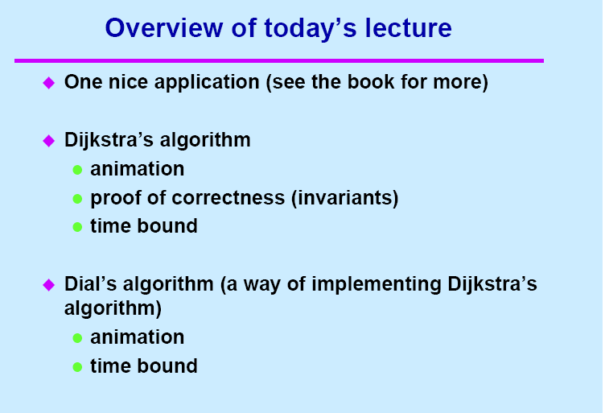

Slide 48
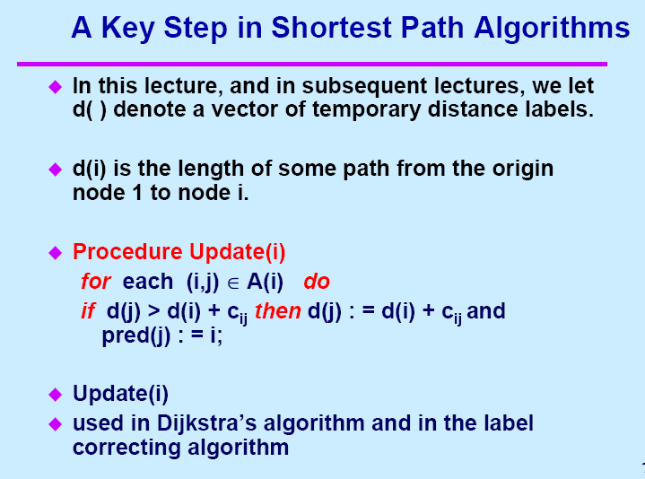

Slide 49
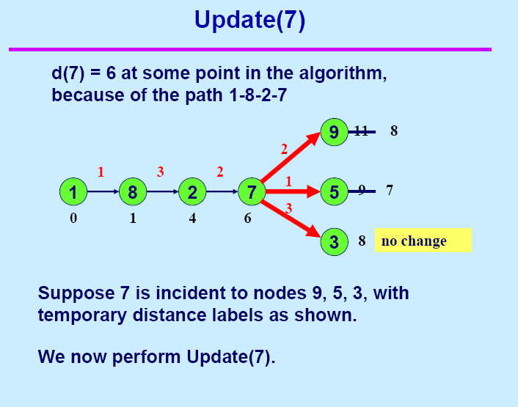

Slide 50
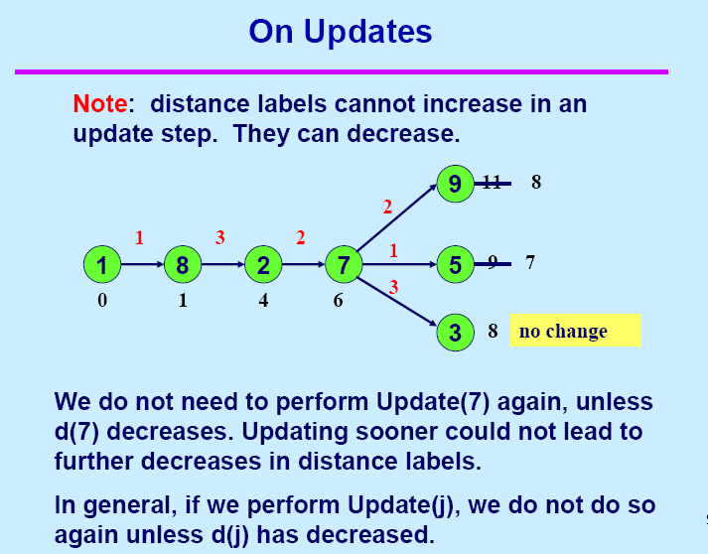

Slide 51
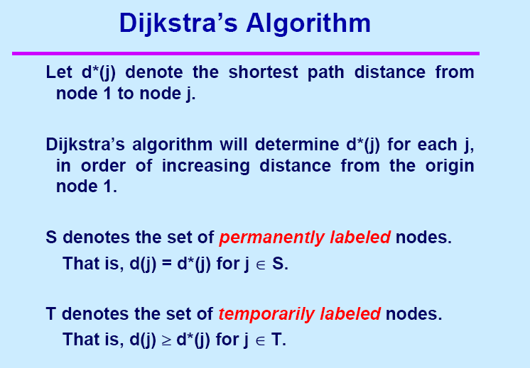

Slide 52
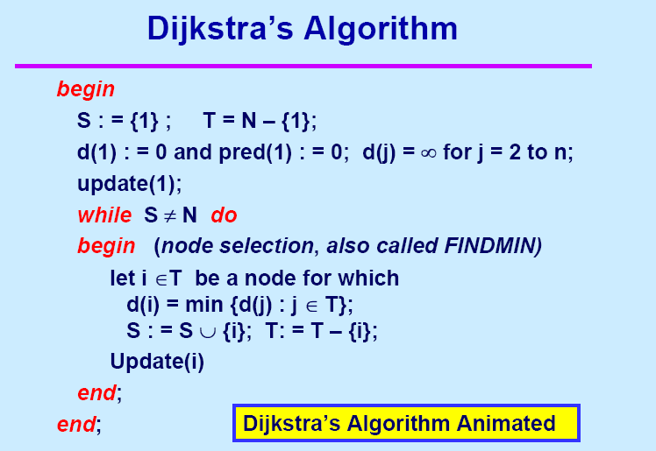

Slide 53
Dijkstra’s Algorithm
Notes:
Obtain a network, and use the same network to illustrate the shortest path problem for communication networks, the max flow problem, the minimum cost flow problem, and the multicommodity flow problem. This will be a very efficient way of introducing the four problems. (Perhaps under 10 minutes of class time.)

Slide 54
An Example
∞
∞
2
4
4
0
2
2
1
1
2
3
∞
1
6
4
2
3
3
5
∞
∞
Initialize
Select the node with the minimum temporary distance label.

Slide 55
Update Step
2
∞
∞
2
4
4
0
2
2
1
1
2
3
6
∞
4
2
3
3
5
∞
∞
4

Slide 56
Choose Minimum Temporary Label
2
∞
2
4
4
0
2
2
1
1
2
3
6
∞
4
2
3
3
5
4
∞

Slide 57
Update Step
6
2
∞
2
4
4
0
2
2
1
1
2
3
6
∞
4
2
3
3
5
4
∞
3
4
The predecessor of node 3 is now node 2

Slide 58
Choose Minimum Temporary Label
2
6
2
4
4
0
2
2
1
1
2
3
6
∞
4
2
3
3
5
3
4

Slide 59
Update
2
6
2
4
4
0
2
2
1
1
2
3
6
∞
4
2
3
3
5
3
4
d(5) is not changed.

Slide 60
Choose Minimum Temporary Label
2
6
2
4
4
0
2
2
1
1
2
3
6
∞
4
2
3
3
5
3
4

Slide 61
Update
2
6
2
4
4
0
2
2
6
1
1
2
3
6
∞
4
2
3
3
5
3
4
d(4) is not changed

Slide 62
Choose Minimum Temporary Label
2
6
2
4
4
0
2
2
1
1
2
3
6
6
4
2
3
3
5
3
4

Slide 63
Update
2
6
2
4
4
0
2
2
1
1
2
3
6
6
4
2
3
3
5
3
4
d(6) is not updated

Slide 64
Choose Minimum Temporary Label
2
6
2
4
4
0
2
2
1
1
2
3
6
6
4
2
3
3
5
3
4
There is nothing to update

Slide 65
End of Algorithm
2
6
2
4
4
0
2
2
1
1
2
3
6
6
4
2
3
3
5
3
4
All nodes are now permanent
The predecessors form a tree
The shortest path from node 1 to node 6 can be found by tracing back predecessors

Slide 66
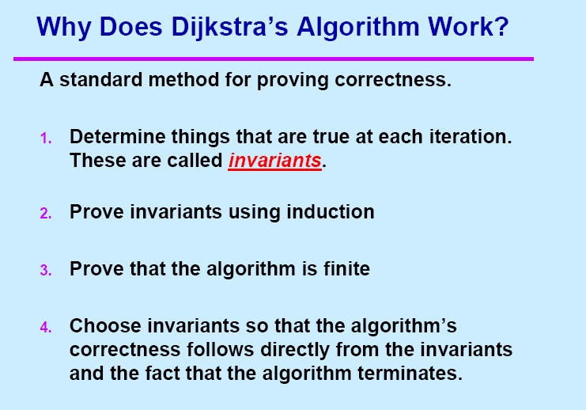

Slide 67
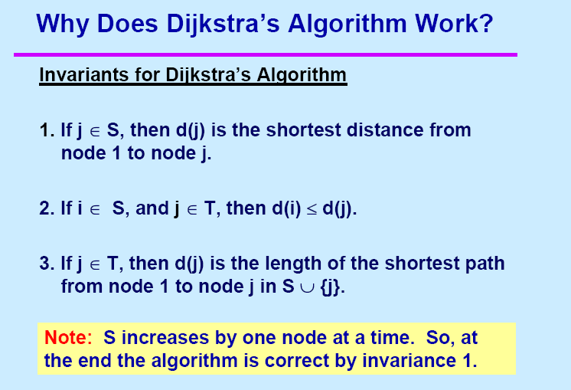

Slide 68
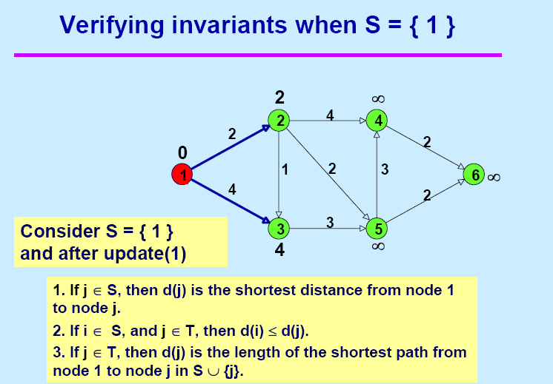

Slide 69
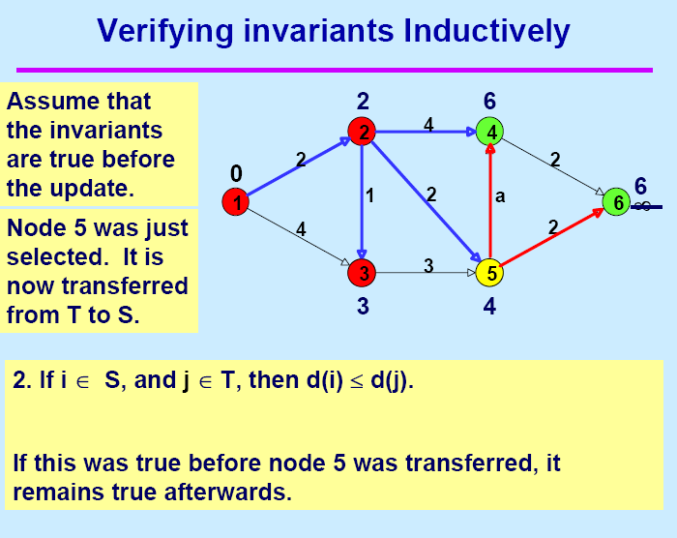

Slide 70
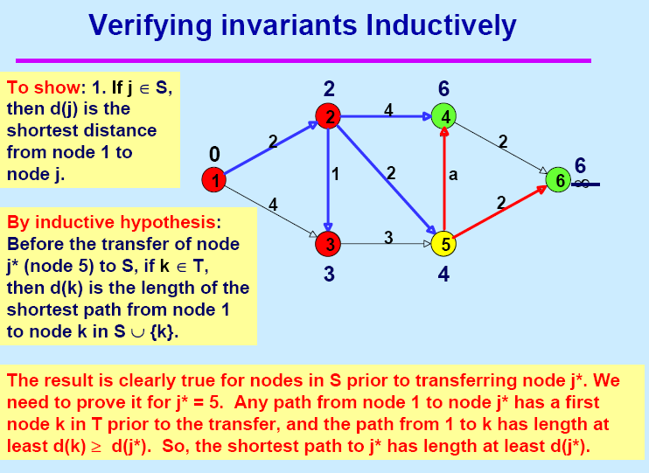

Slide 71
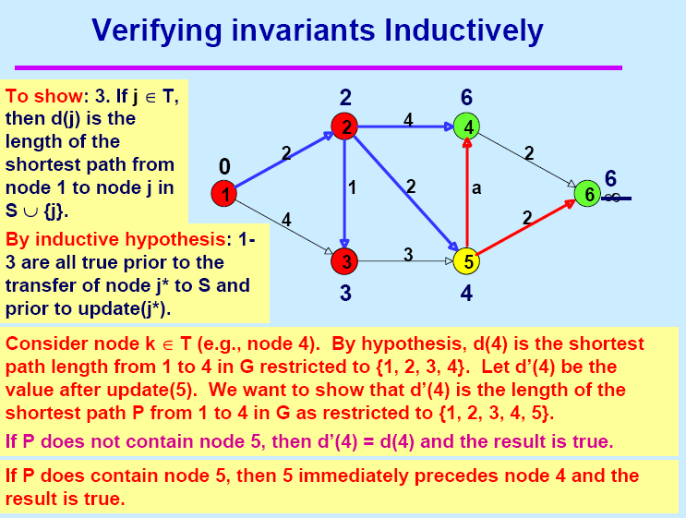

Slide 72
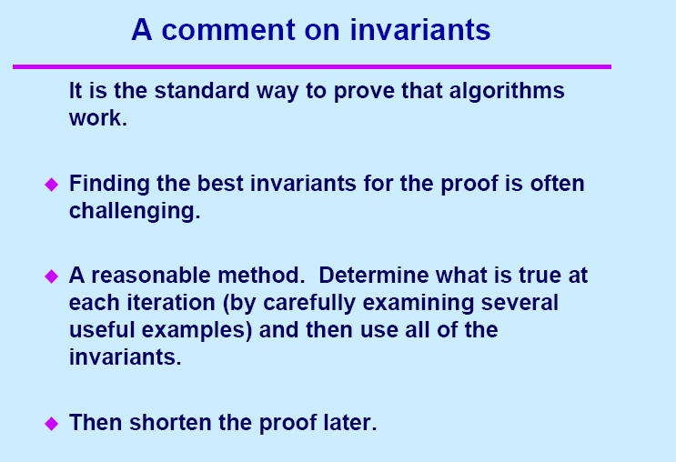

Slide 73
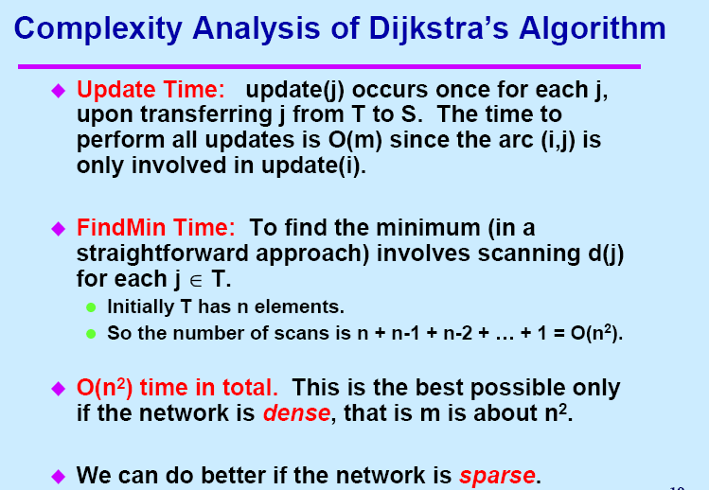

Slide 74
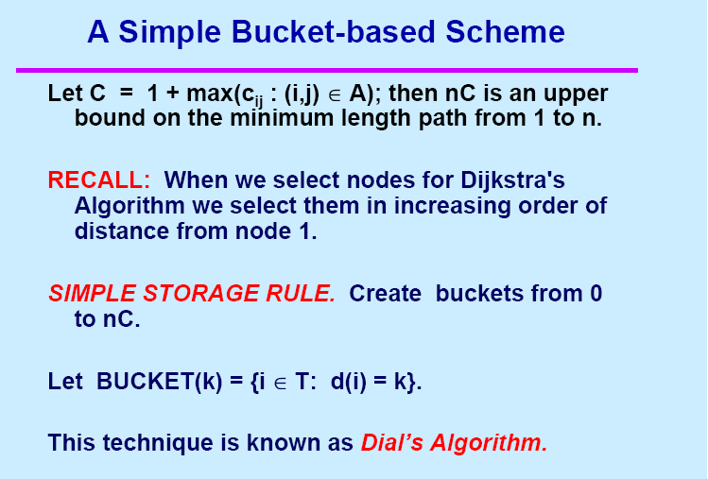

Slide 75
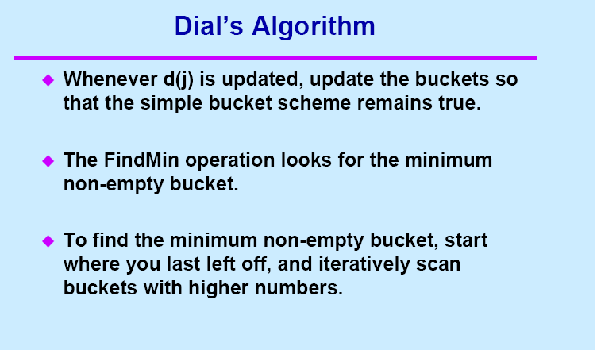

Slide 76
Dijkstra’s Algorithm with simple buckets
(also known as Dial’s algorithm)
Notes:
Obtain a network, and use the same network to illustrate the shortest path problem for communication networks, the max flow problem, the minimum cost flow problem, and the multicommodity flow problem. This will be a very efficient way of introducing the four problems. (Perhaps under 10 minutes of class time.)

Slide 77
An Example
Initialize distance labels
∞
∞
2
4
4
Initialize buckets.
0
2
2
1
1
2
3
∞
1
6
4
2
Select the node with the minimum temporary distance label.
3
3
5
∞
∞
∞
2
0
1
2
3
4
5
6
7
3
4
1
5
6

Slide 78
Update Step
2
∞
∞
2
4
4
0
2
2
1
1
2
3
6
∞
4
2
3
3
5
∞
∞
∞
4
2
0
1
2
3
4
5
6
7
3
4
1
2
3
5
6

Slide 79
Choose Minimum Temporary Label
Find Min by starting at the leftmost bucket and scanning right till there is a non-empty bucket.
2
∞
2
4
4
0
2
2
1
1
2
3
6
∞
4
2
3
3
5
∞
4
∞
0
1
2
3
4
5
6
7
4
5
2
3
6

Slide 80
Update Step
6
2
∞
2
4
4
0
2
2
1
1
2
3
6
∞
4
2
3
3
5
∞
4
∞
4
3
0
1
2
3
4
5
6
7
4
5
2
3
3
4
6
5

Slide 81
Choose Minimum Temporary Label
Find Min by starting at the leftmost bucket and scanning right till there is a non-empty bucket.
2
6
2
4
4
0
2
2
1
1
2
3
6
∞
4
2
3
3
5
∞
3
4
0
1
2
3
4
5
6
7
3
5
4
6

Slide 82
Update
2
6
2
4
4
0
2
2
1
1
2
3
6
∞
4
2
3
3
5
∞
3
4
0
1
2
3
4
5
6
7
3
5
4
6

Slide 83
Choose Minimum Temporary Label
2
6
2
4
4
0
2
2
1
1
2
3
6
∞
4
2
3
3
5
∞
3
4
0
1
2
3
4
5
6
7
5
4
6

Slide 84
Update
2
6
2
4
4
0
2
2
6
1
1
2
3
6
∞
4
2
3
3
5
∞
3
4
0
1
2
3
4
5
6
7
5
4
6
6

Slide 85
Choose Minimum Temporary Label
2
6
2
4
4
0
2
2
1
1
2
3
6
6
4
2
3
3
5
3
4
0
1
2
3
4
5
6
7
4
6

Slide 86
Update
2
6
2
4
4
0
2
2
1
1
2
3
6
6
4
2
3
3
5
3
4
0
1
2
3
4
5
6
7
4
6

Slide 87
Choose Minimum Temporary Label
2
6
2
4
4
There is nothing to update
0
2
2
1
1
2
3
6
6
4
2
3
3
5
3
4
0
1
2
3
4
5
6
7
6

Slide 88
End of Algorithm
2
6
2
4
4
0
2
2
1
1
2
3
6
6
4
2
3
3
5
3
4
All nodes are now permanent
The predecessors form a tree
The shortest path from node 1 to node 6 can be found by tracing back predecessors

Slide 89
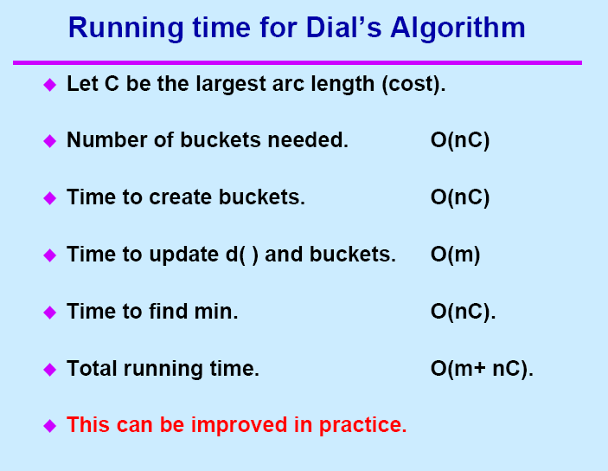

Slide 90
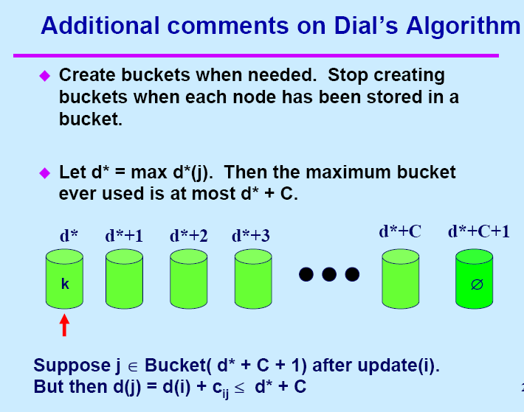

Slide 91
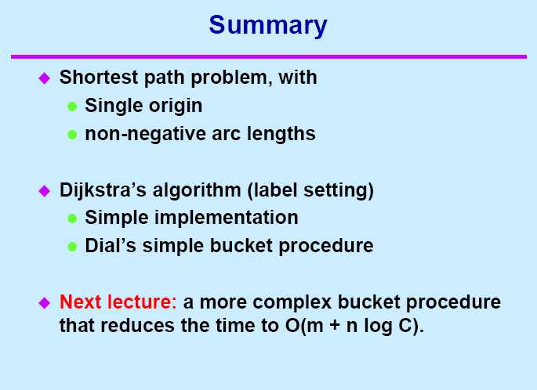

Slide 92



Implementations
With min-priority queue, Dijkstra algorithm can be
implemented in time
With Fibonacci heap, Dijkstra algorithm can be implemented
in time
With Radix heap, Dijkstra algorithm can be implemented
in time

